Slide 1

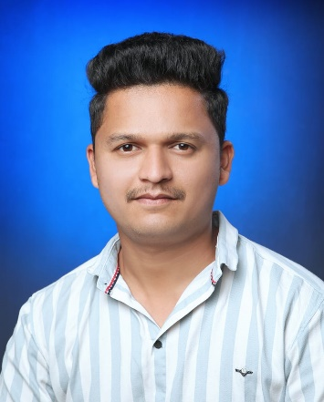


Pranav B. kumbhar.
Education and certificates
Bachelor of Technology Civil Engineering : 2018 - 2021
Analyst/Software Engineer
Skills
Core java
React Framework
Database
Spring Boot
Spring MVC
Node JS
Base Location: Mumbai
Email ID:
Pranav.Bhaskar-kumbhar@capgemini.com
_{Mobile No:} +91 9049252449
Grade:
A4
Backend
Spring Boot
Spring MVC
REST-API
Strengths
•A self-driven learner with Front-End and BackEnd knowledge. Passionate about implementing and launching new projects.
•Ready to learn new technologies/frameworks and implement them to further improve my knowledge.
•A team player with good communication skill always ready to work for the enrichment of knowledge
•Has working knowledge on React and Java Microservice Development using Spring framework on a beginner level.
•Have decent knowledge on Databases like Oracle SQL, My SQL and Postgres SQL
Achievement
Online Railway Reservation System Application :
Completed end to end case study of Online Railway Reservation System Application using Spring boot and React used for user interface. It is a double-role application project i.e. Admin and User, where Admin will have the main control over the system. Admin will be responsible for maintaining the system and also, keeping a check on the availability of trains, and updating any details related to the reservation system. On the other hand, Users can register themselves and can do online booking of trains.
Database
Postgres SQL
MongoDB
Web Technologies
HTML5 CSS3
Javascript
Certifications:
AWS Certified Solutions Architect - Associate
AddOns Github Maven Postman
Additional Details
Excellent Communication Skills
Team Player
Presentation Title | Author | Date © Capgemini 2017. All rights reserved | 1

